Slide 1
Smithgall Woods Park Website
Project Update
MIST7591E – MBT Project II
Andrea Castresana
Jennifer Lazo
Alexander Couch
Clark Williams
Eliseo Santos
February 7, 2018

Slide 2
Overview
Project Background
Selected Theme Customization
Available Plugins & Limitations
Volunteer App Options
Project Schedule
Way Ahead

Slide 3
Project Background
Problem
Difficult to update/maintain site and Volunteer app
Outdated PHP, WP themes and plugins
Degraded site security
Solution
Rebuild site using current WordPress/PHP
Site hosting either 1&1.com or Bluehost
Establish detailed Admin Documentation
Train FSGW Reps
Notes:
Criteria for website hosting:
Code must be accessible and portable
Cost must be below $20
Site security must be include SiteLock and SSL Certificate

Slide 4
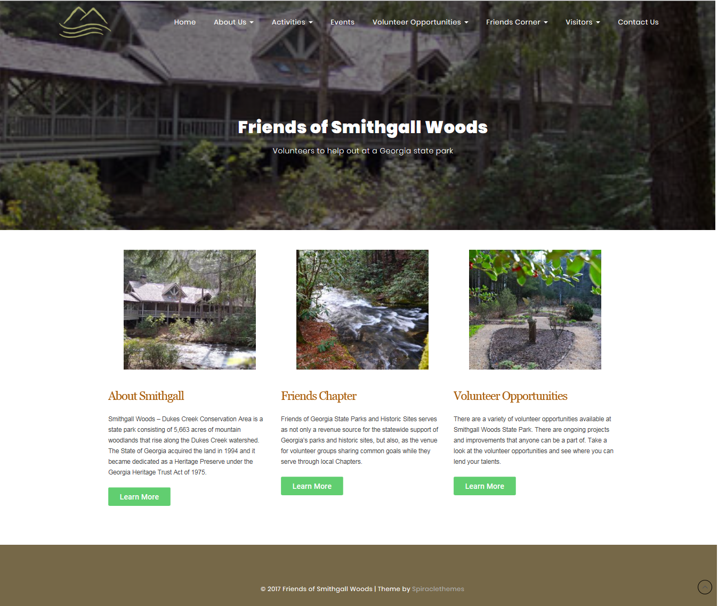
Selected WP Theme

Slide 5
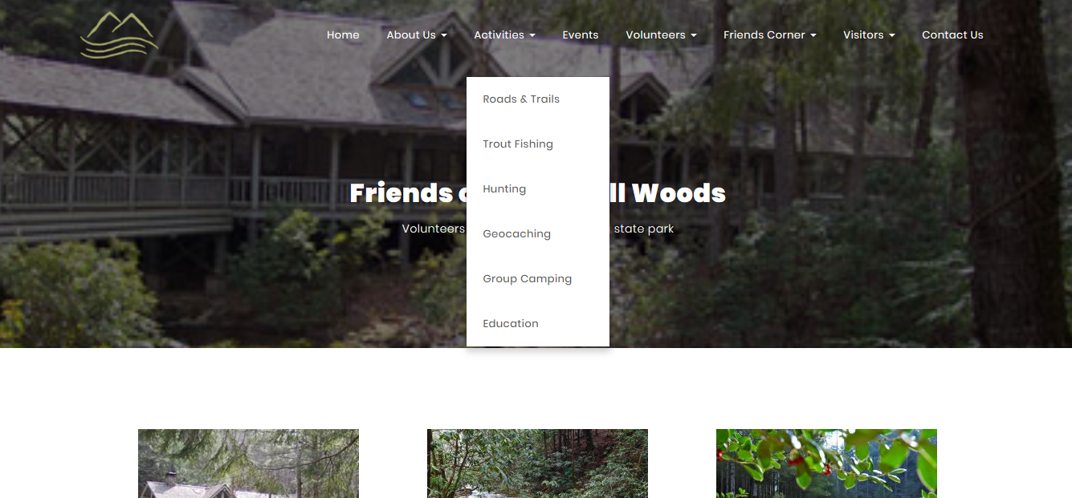
Selected Theme Customization
Collect page content for All Access Trail
Create new page on site

Slide 6
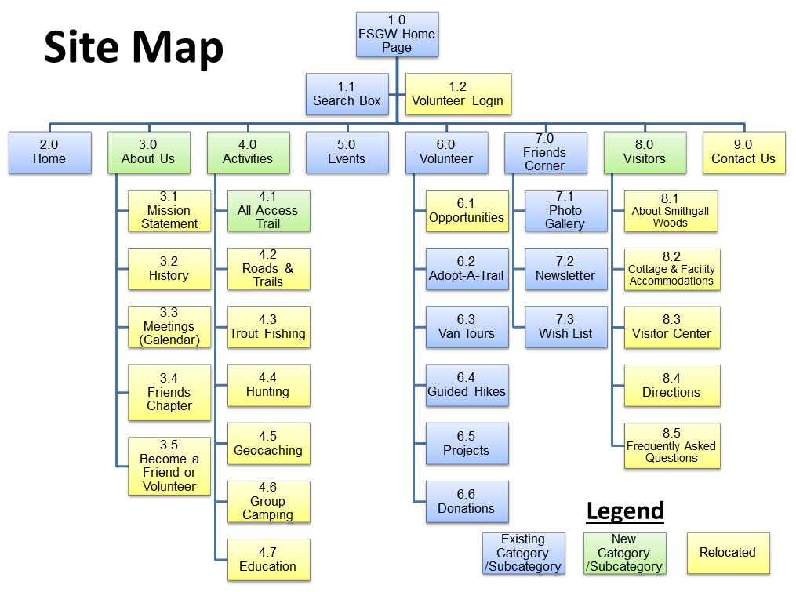
Selected Theme Customization
Arrange pages & contents to match site map

Slide 7
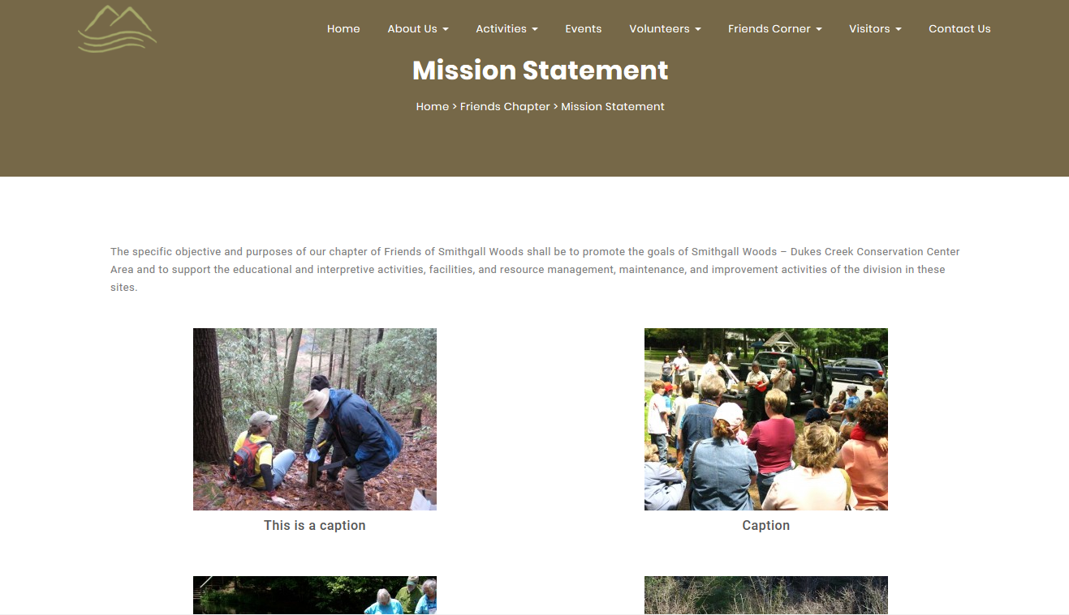
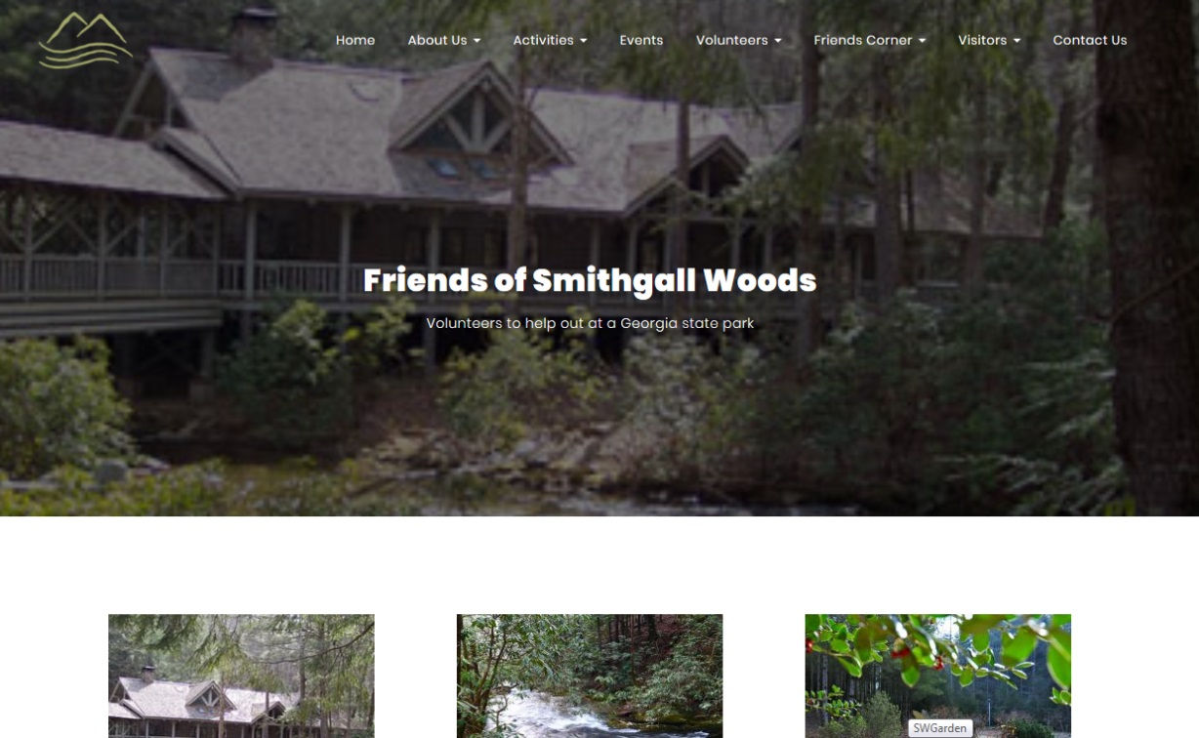
Selected Theme Customization
Add slider & search box to Home Page
Adjust font size

Slide 8
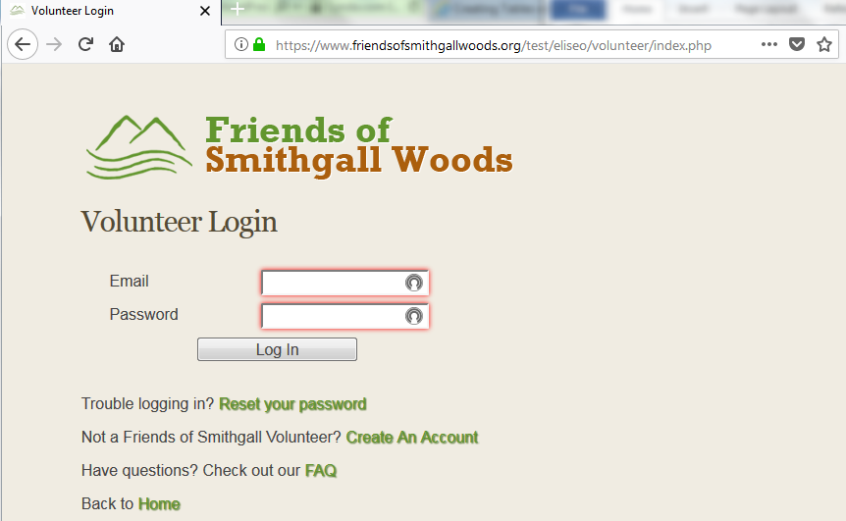
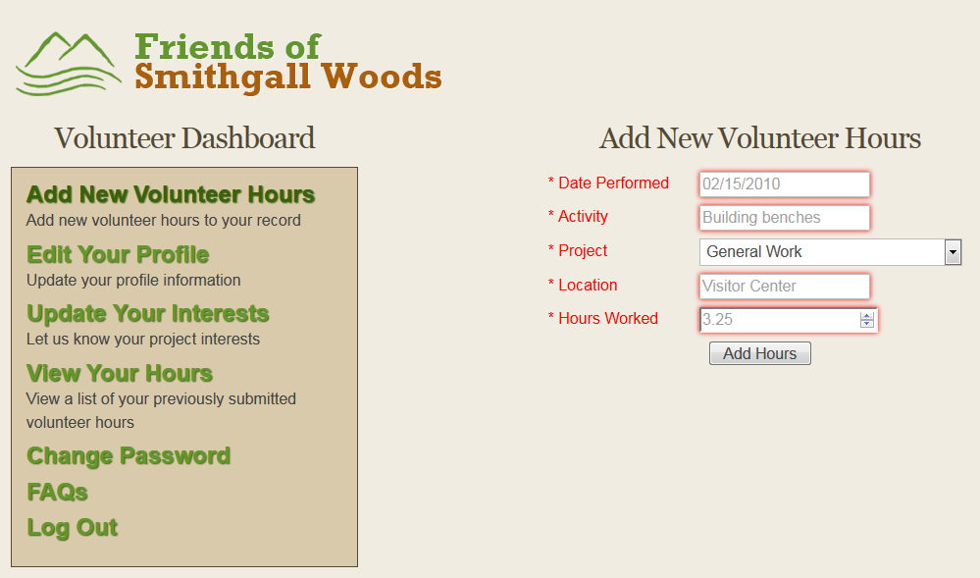
Existing Volunteer App
Stand-alone app linked from WP site

Slide 9
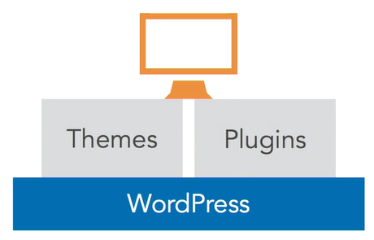
Available Plugins & Limits
Goal: Bring Volunteer App inside WP
54,000+ WP Plugins
Plugins use built-in WP DB Tables
Mostly non-customizable DB tables
Will not allow migration of app DB tables
Negative impact to Volunteer App & Reports App
Notes:
The available plugins have some limitations. Since WP uses a built-in database that is established during the initial setup, it prevents you from altering the DB table structure. Some plugins add their own tables to the WP DB.

Slide 10
Volunteer App Option #1

Slide 11
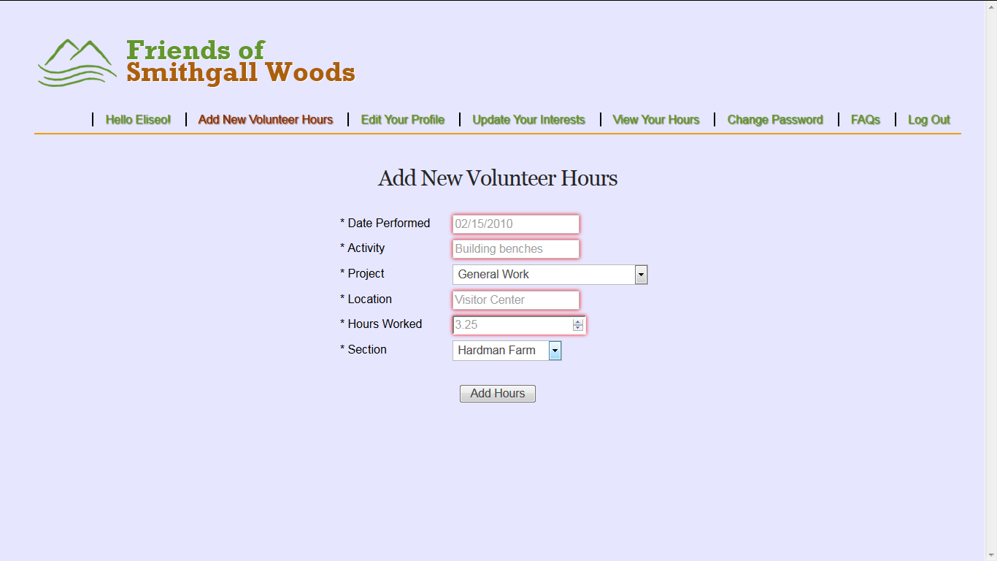
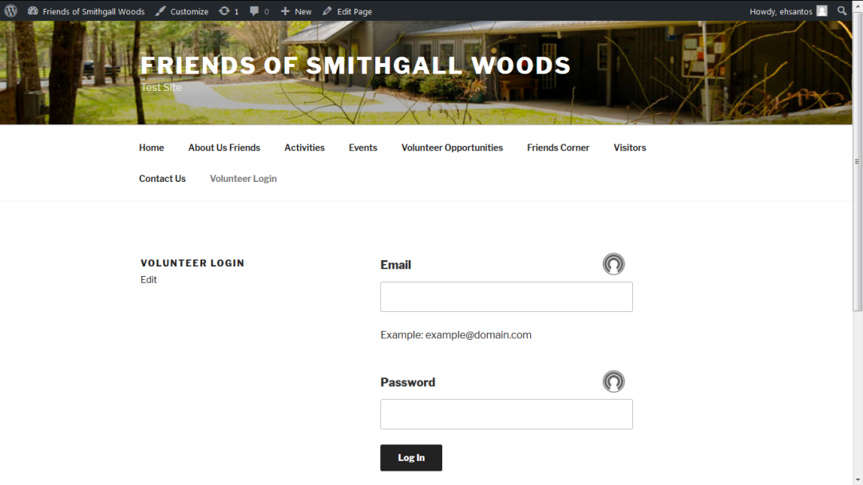
Volunteer App Option #1
Embed App Login Page inside WP
Add Navigation Bar & Login Name
Add Section Field for Hardman Farm & SGW

Slide 12
Volunteer App Option #2

Slide 13
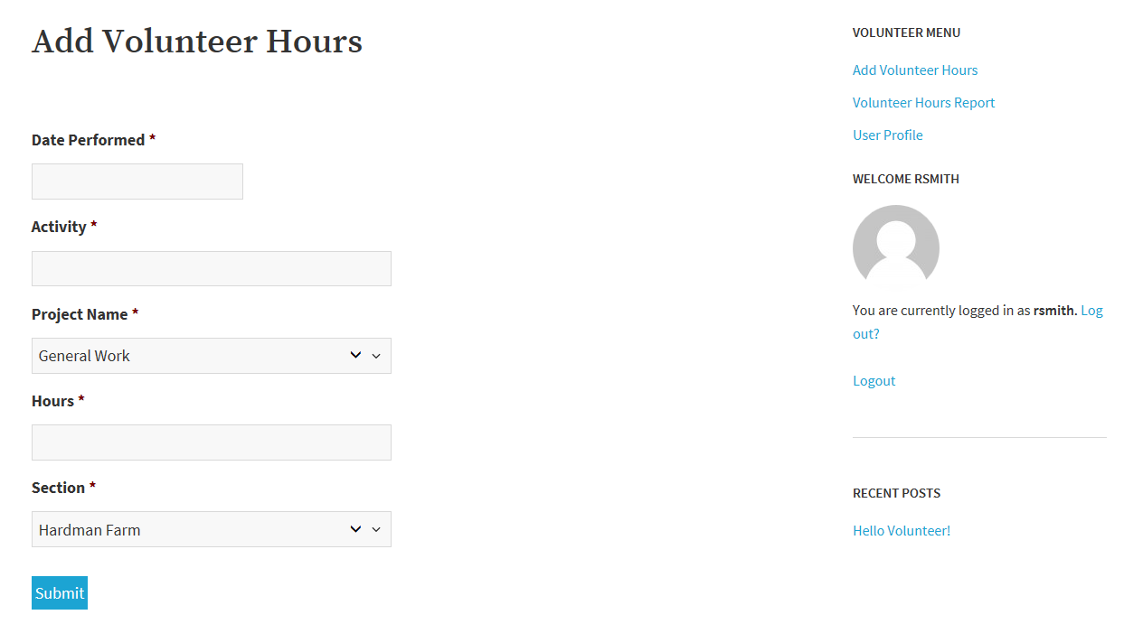
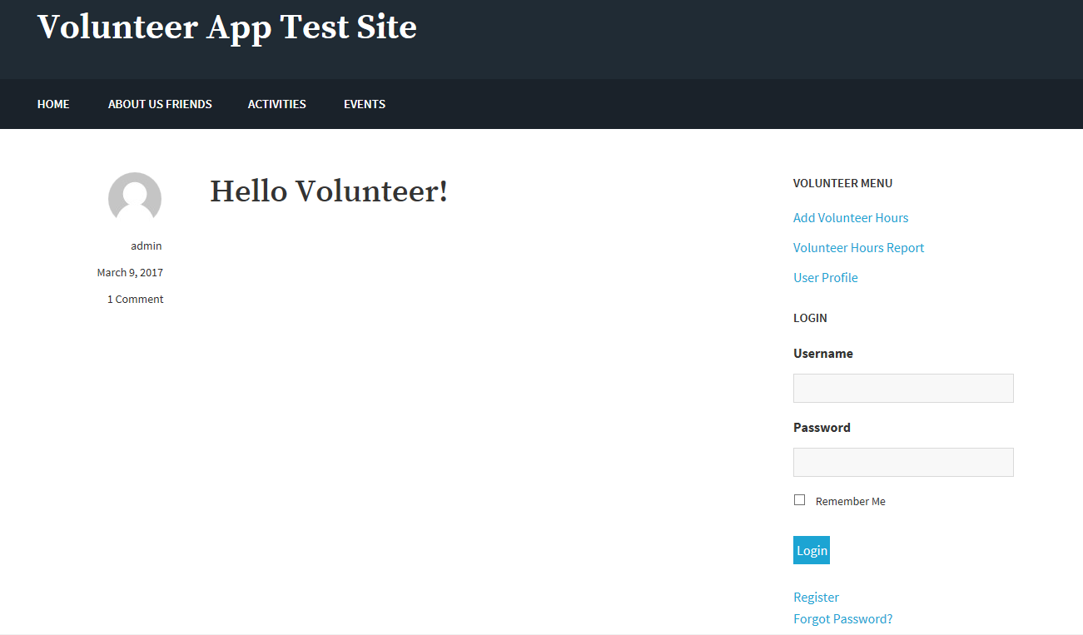
Volunteer App Option #2
Purchase Gravity Forms & GravityView
~$400 yearly license

Slide 14
Volunteer App Option #2
Purchase Gravity Forms & GravityView
~$400 yearly license
Technical Support is available
User interface is pretty straightforward
Easy to install required plugin/add-on updates
Reliable and stable with consistent updates
Easy to update and maintain WP site & app
Ensures site/app security is always updated

Slide 15
Volunteer App Option #3

Slide 16
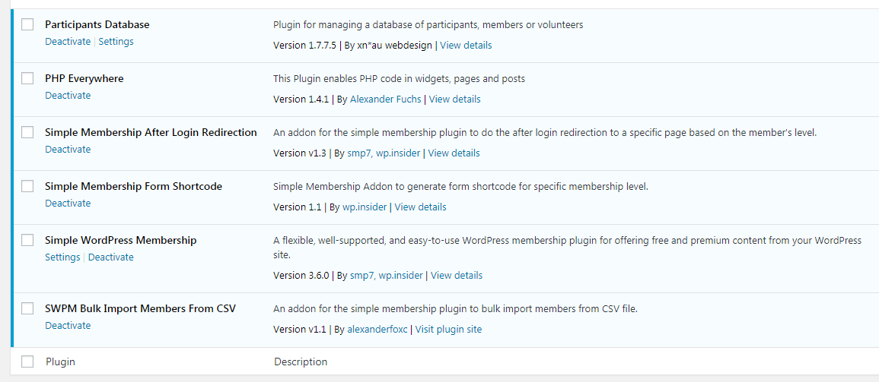
Volunteer App Option #3
Use six free WP plugins/add-ons

Slide 17
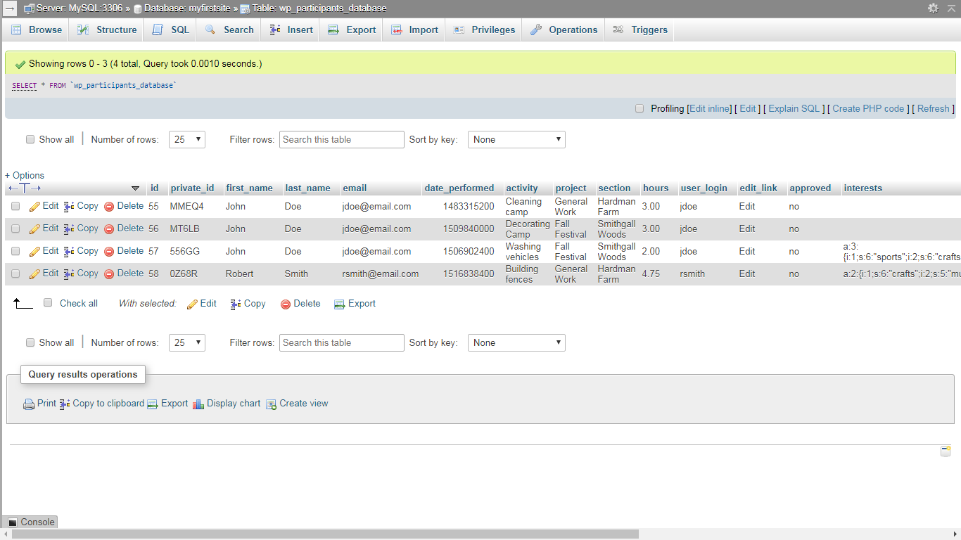
Volunteer App Option #3
Volunteer Hours DB

Slide 18
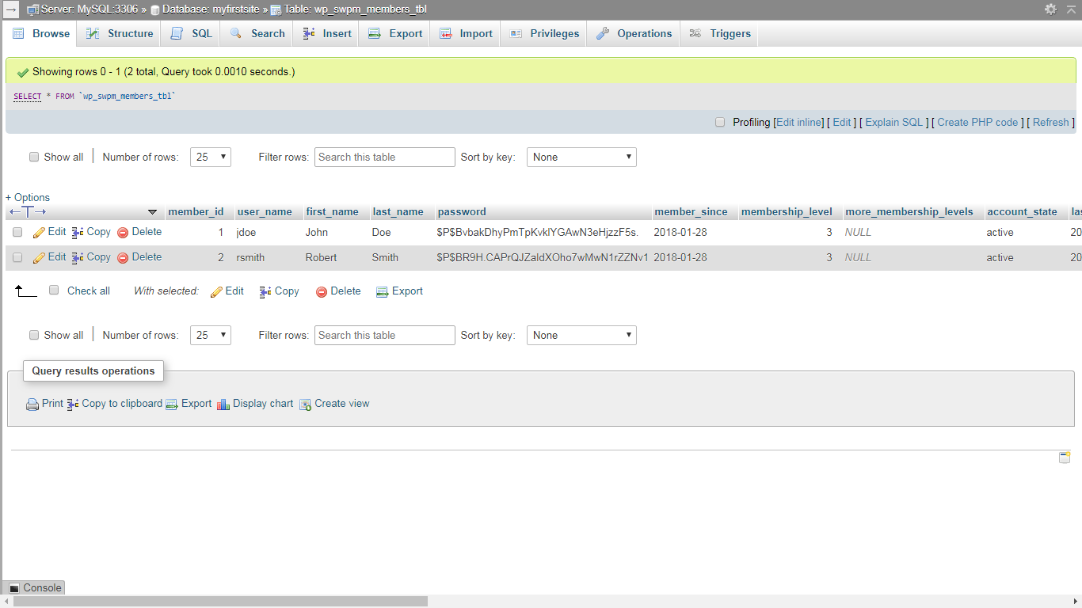
Volunteer App Option #3
User Registration & Profile DB

Slide 19
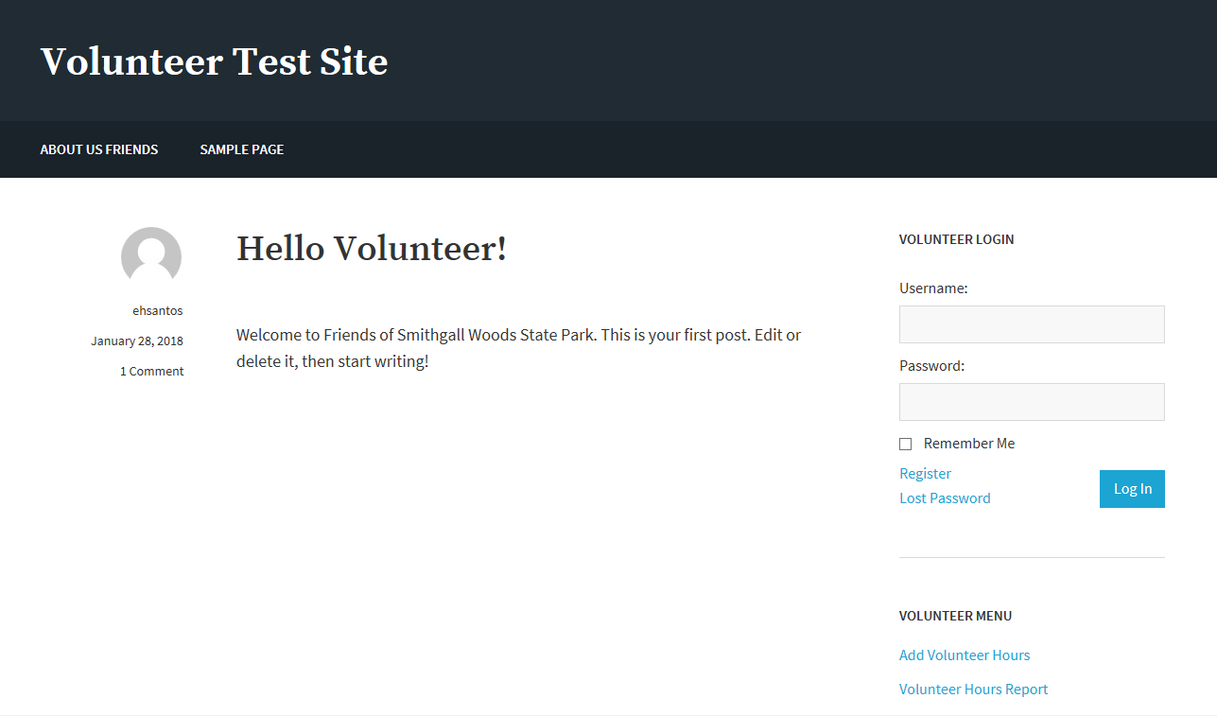
Volunteer App Option #3
Demo Site using free plugins/add-ons

Slide 20
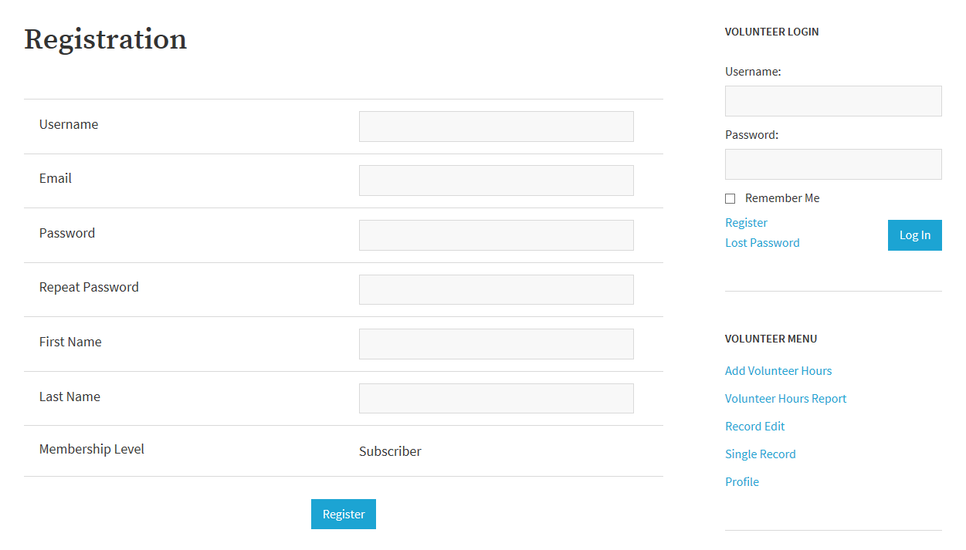
Volunteer App Option #3
Registration Page with 3 levels of access

Slide 21
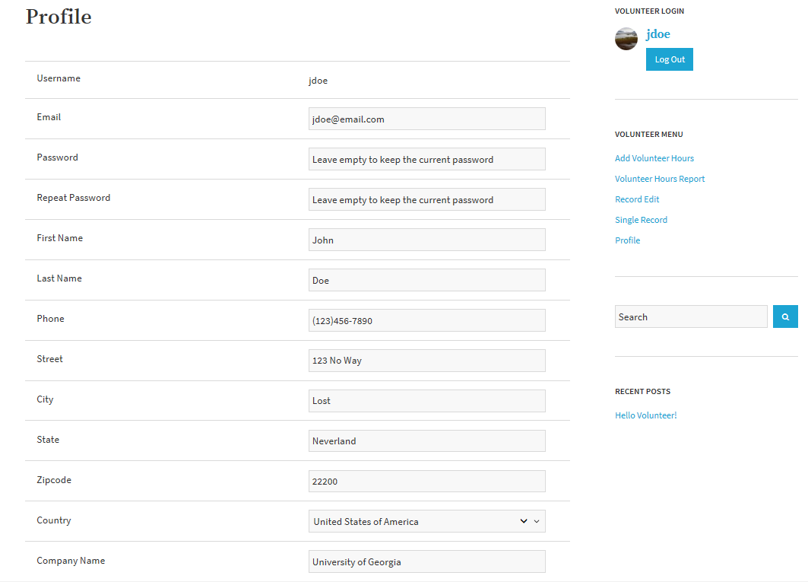
Volunteer App Option #3
User Profile Page to edit member info

Slide 22
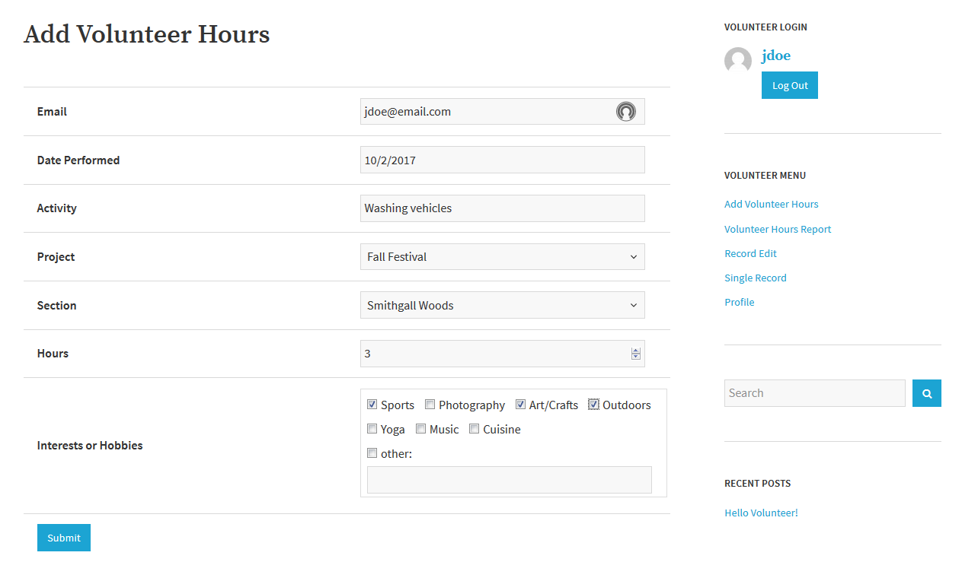
Volunteer App Option #3
Volunteer Hours Submission Page

Slide 23
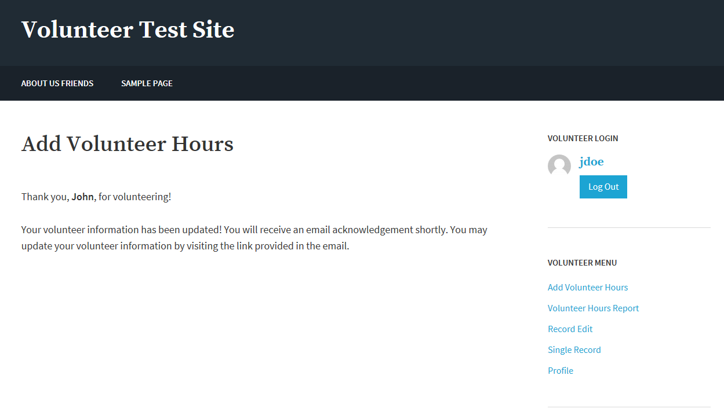
Volunteer App Option #3
Submission Confirmation Message

Slide 24
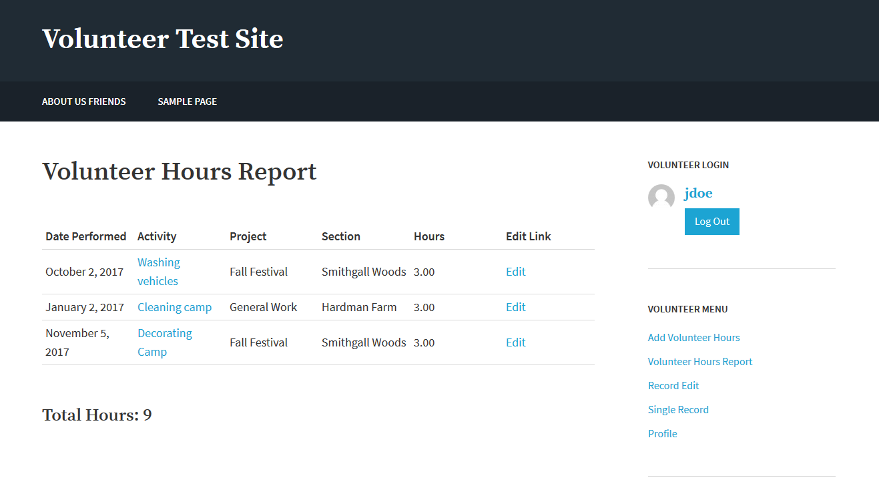
Volunteer App Option #3
Volunteer Report with Edit Link
Activity is linked to volunteer details

Slide 25
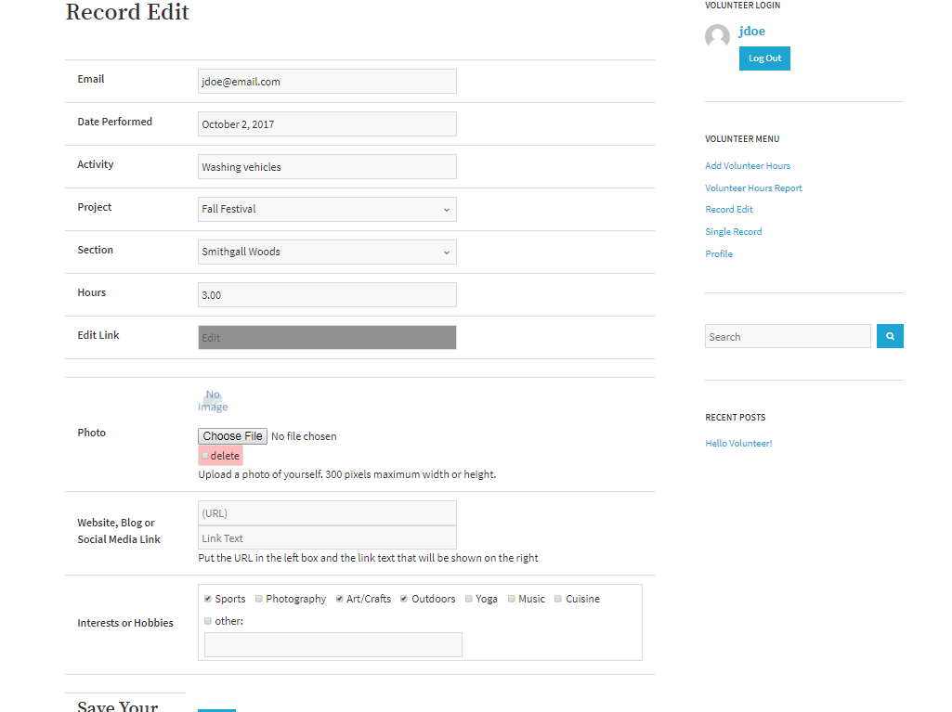
Volunteer App Option #3
Record Page for editing volunteer info

Slide 26
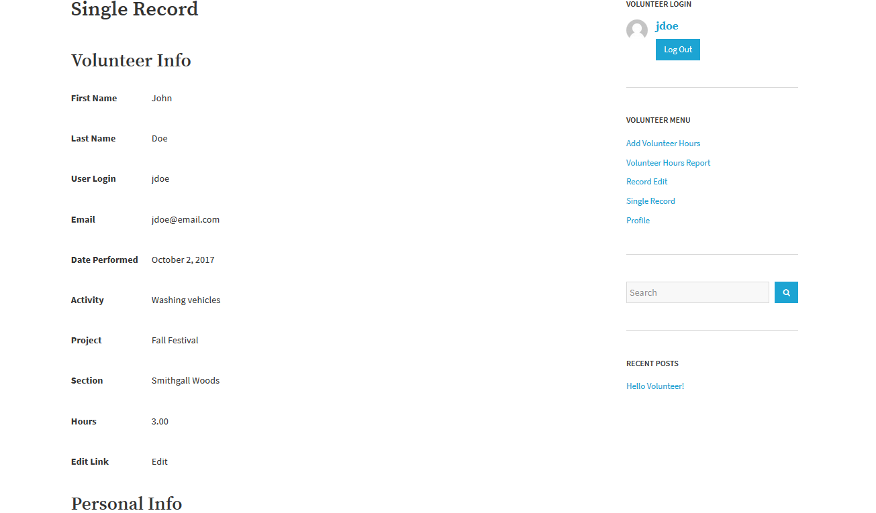
Volunteer App Option #3
Single Record displays volunteer details

Slide 27
Project Schedule
 |  | CY2017 |  |  |  | CY2018
Task Phase | Task Description | S | O | N | D | J | F | M | A
Initiation & Planning | 1. Conduct System Analysis of Current Site
 | 2. Propose Security Remediation Plan
 | 3. Establish Proposed System Requirements
 | 4. Meet with Project Stakeholders
 | 5. Develop Logical Models
 | 6. Conduct Testing of WordPress / Prototype
 | 7. Research Web Content Management Tool
 | 8. Finalize Requirements & Project Charter
Project Execution | 9. Start Rebuilding the Website/Volunteer App
 | 10. Test First Increment Version of Site/App
 | 11. Finish Rebuilding the Entire Site/App
 | 12. Test Final Rebuild of Website/App
Project Closure | 13. Establish Documentation
 | 14. Deploy Production Version of Website
 | 15. Conduct Training on Website Maintenance
 | 16. Hold Project Closure Meeting with Client

Slide 28
Way Ahead
Continue customizing site content with theme
Follow up with Art on Volunteer App Options
Hold off on updating App code to PHP 7.2
Resolve MySQL deprecation by using MySQLi or PDO_MySQL extension

Slide 29
Questions

Slide 30
BACKUPS

Slide 31
How WordPress Works
WordPress Core
Custom Appearance (Themes)
Custom Features & Functionality (Plugins)
Notes:
One of the great things about WordPress is the ability for developers to extend the core functionality of the code base to do just about anything you can think of. So we've got WordPress Core, and that's a stable code base that you can use as a platform to build your site. If you need to add custom features or functionality, instead of directly editing WordPress Core, you use plugins.
WordPress also gives us a way to change the appearance of a website, and that's done through themes. So we've got themes and plugins, where themes control the look of a site and plugins control any site-specific functionality that's needed in addition to WordPress Core.

Slide 32
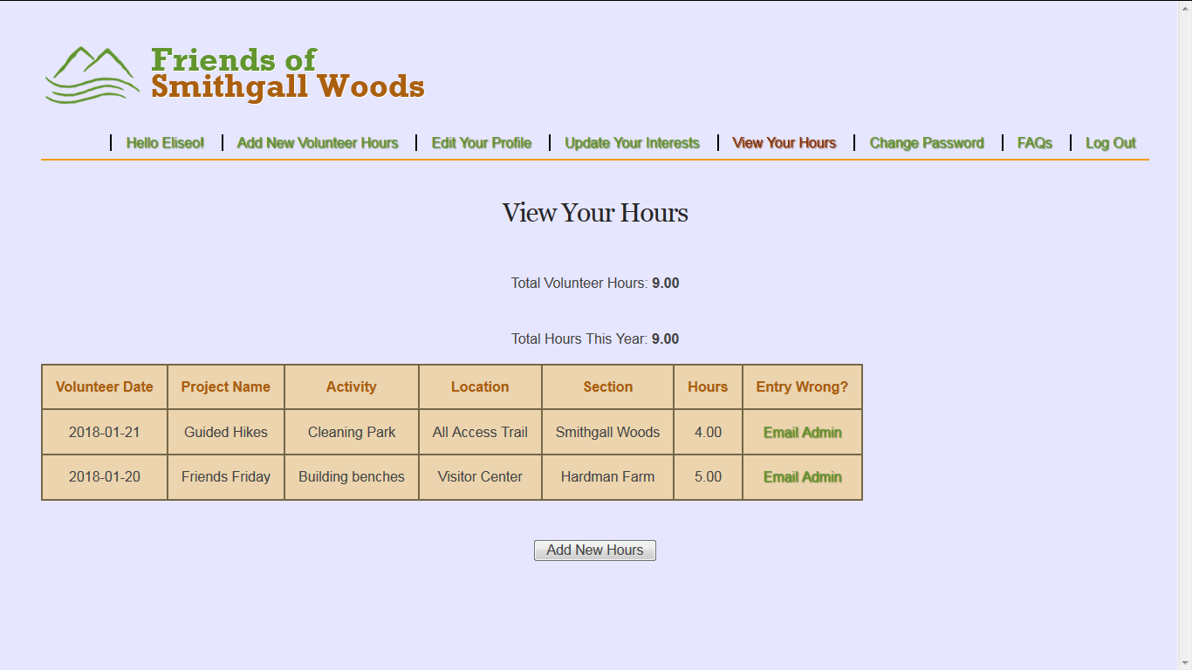
Alt. Solution to Volunteer App
Volunteer Hours View with added Section Field

